Slide 1

How-To
Center for Advanced Analytics: Behavioral Science Task

Slide 2
Comparisons
 | Excel | PowerBI | R
Set up project
See raw data for diagnosis
Factor variables
Remove empty rows
Filter/Select rows
Subset columns
Merge data
Document/Replicate data cleaning process
Descriptive stats, Cross-tabs, Pivot tables
Visualize data
Run statistical tests
Notes:
While RStudio is harder to set up initially (with GitHub), it’s better for transforming data and documenting a replicable process.
Excel is better for seeing the raw data (while Power BI is better at transforming it) and easier to manipulate the data viz options but is limited in statistical analyses.

Slide 3
Set up Project

Slide 4


Slide 5
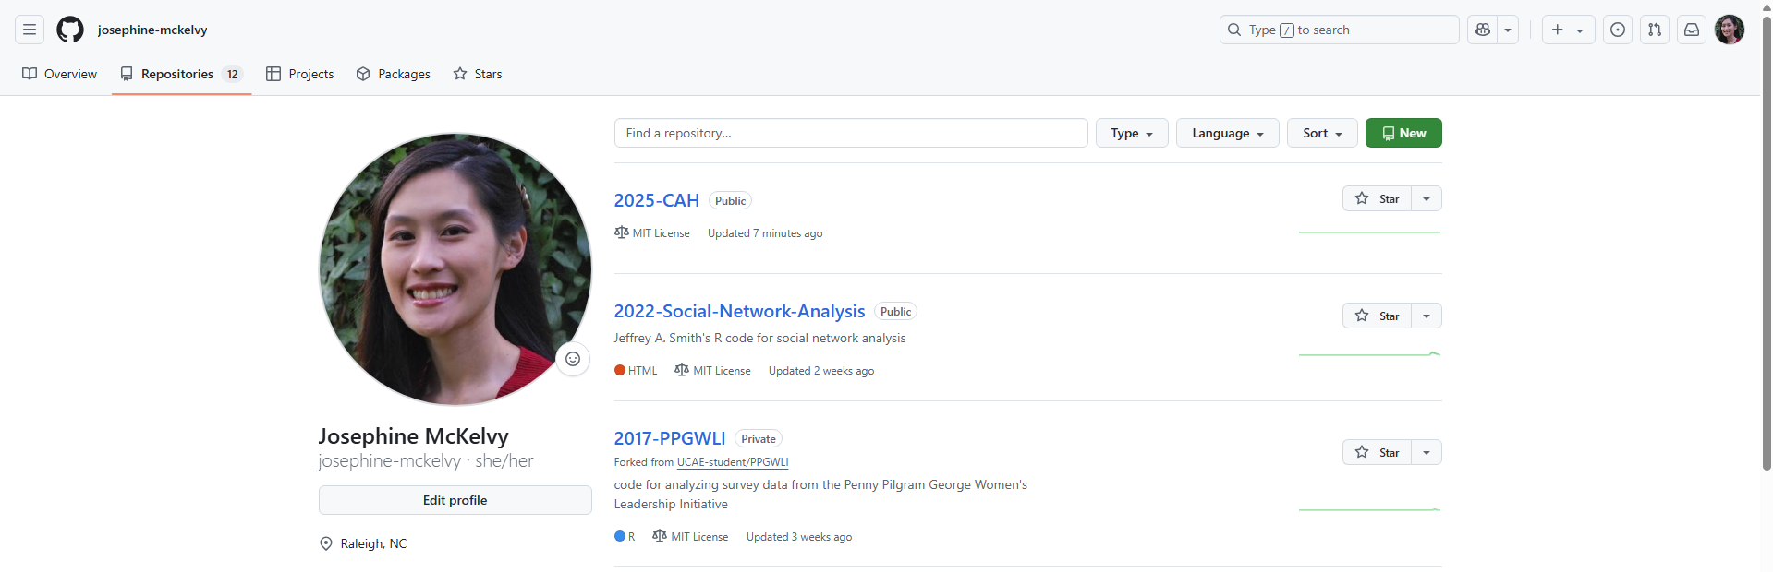
Notes:
Sign in to GitHub.
Create a new repository.

Slide 6
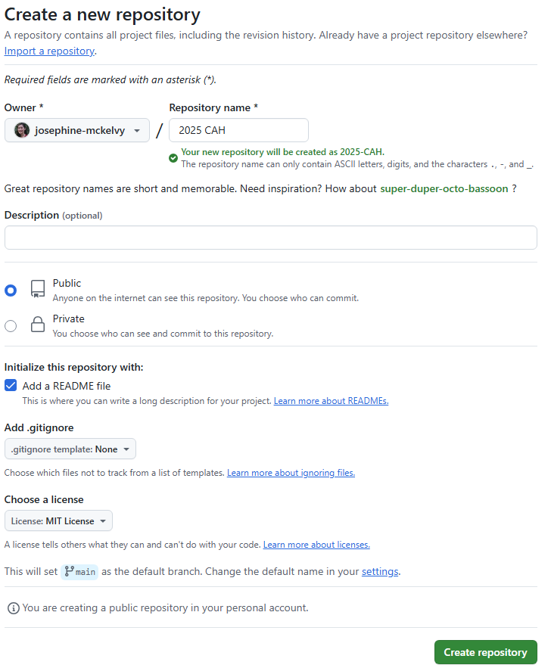
Notes:
Name the repository.
Add a README file.
Choose a license.

Slide 7


Slide 8
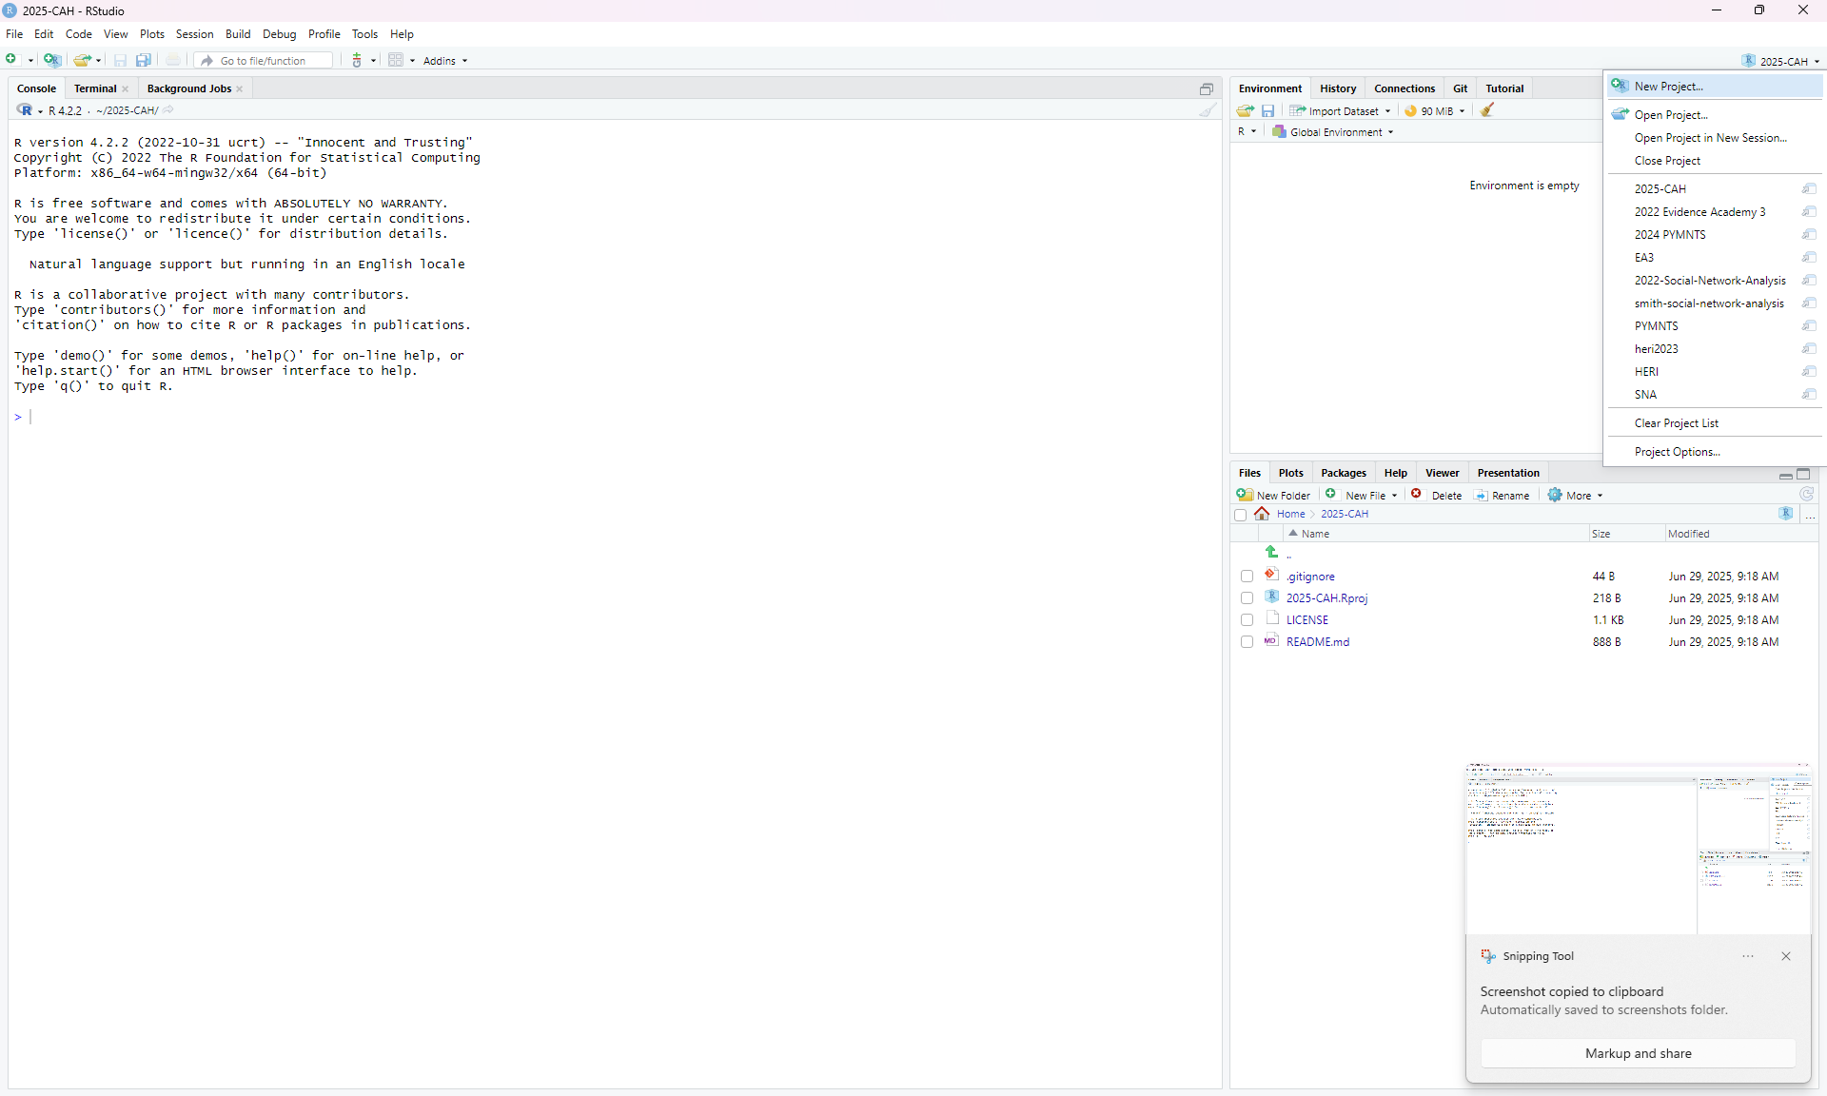
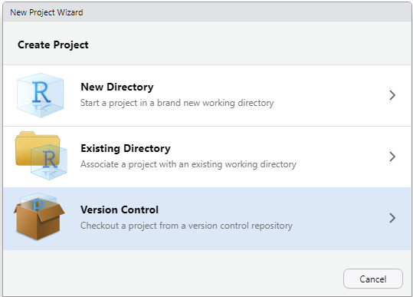
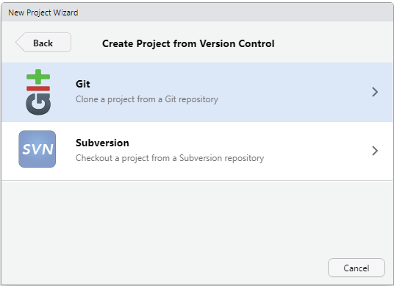
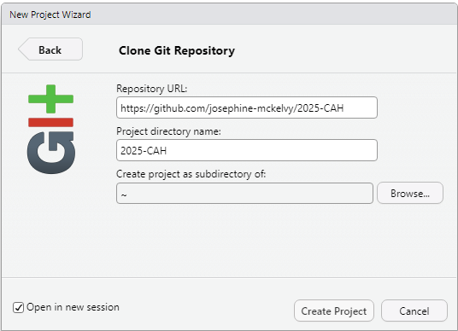
Notes:
Create a New Project.
Checkout a project from a Version Control repository.
Clone a project from a Git repository.
Use the URL for the repository you just created in GitHub.

Slide 9
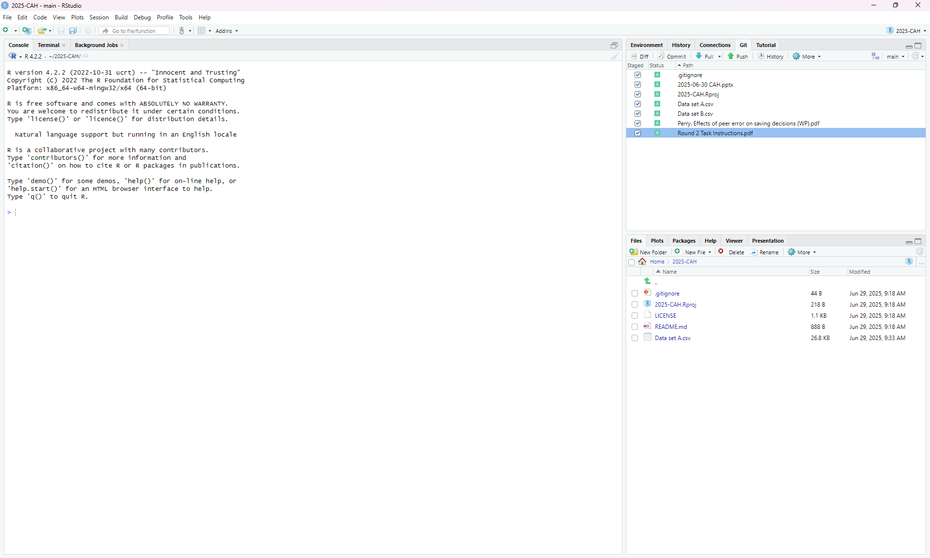
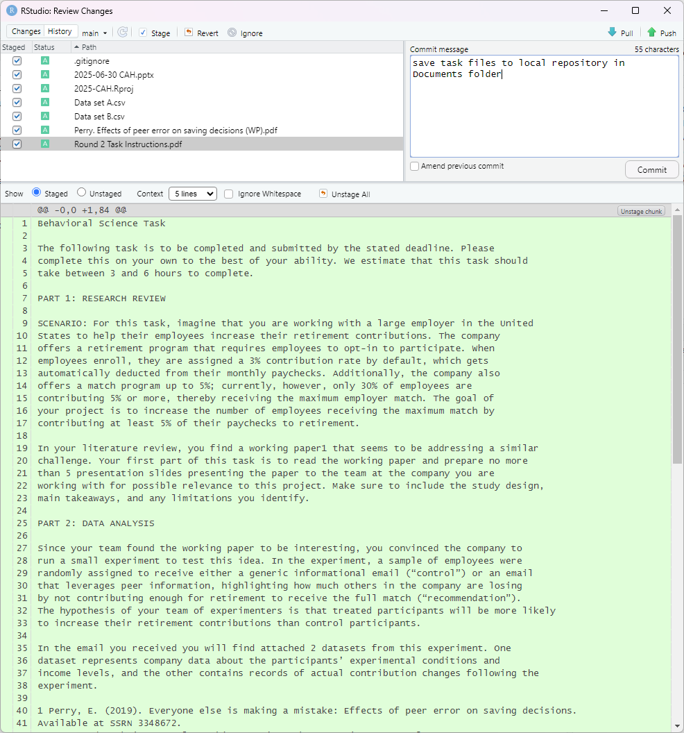
Notes:
Save task files to local repository (i.e., the relevant folder created in My Documents folder).
In the Git window, select changes to Commit (or save).
Describe changes, Commit changes, and Push changes to GitHub.

Slide 10


Slide 11
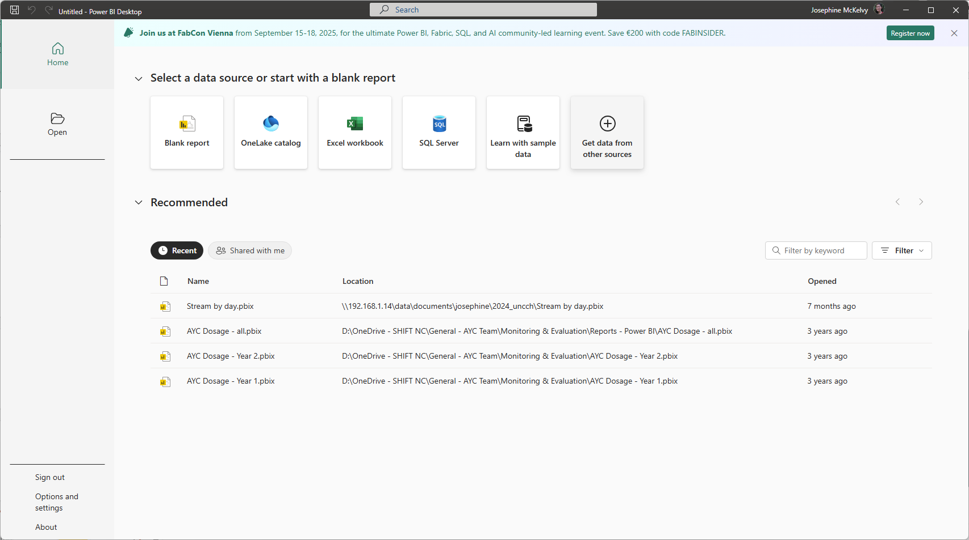
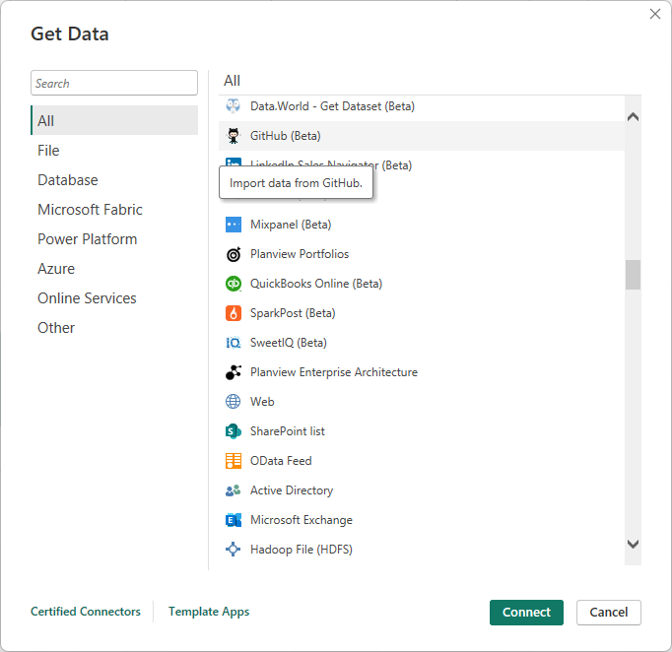
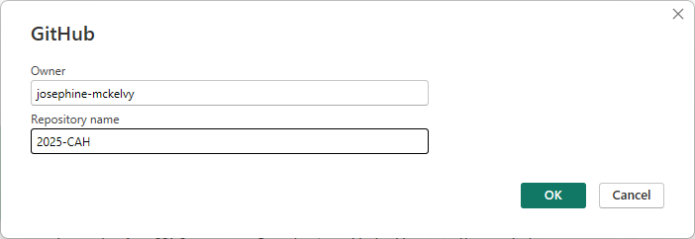
Notes:
PowerBI: Get data from other sources
GitHub:
Enter username for Owner and Repository Name.
Sign in.
Authorize.
Connect.

Slide 12
Load, Clean, Transform Data

Slide 14
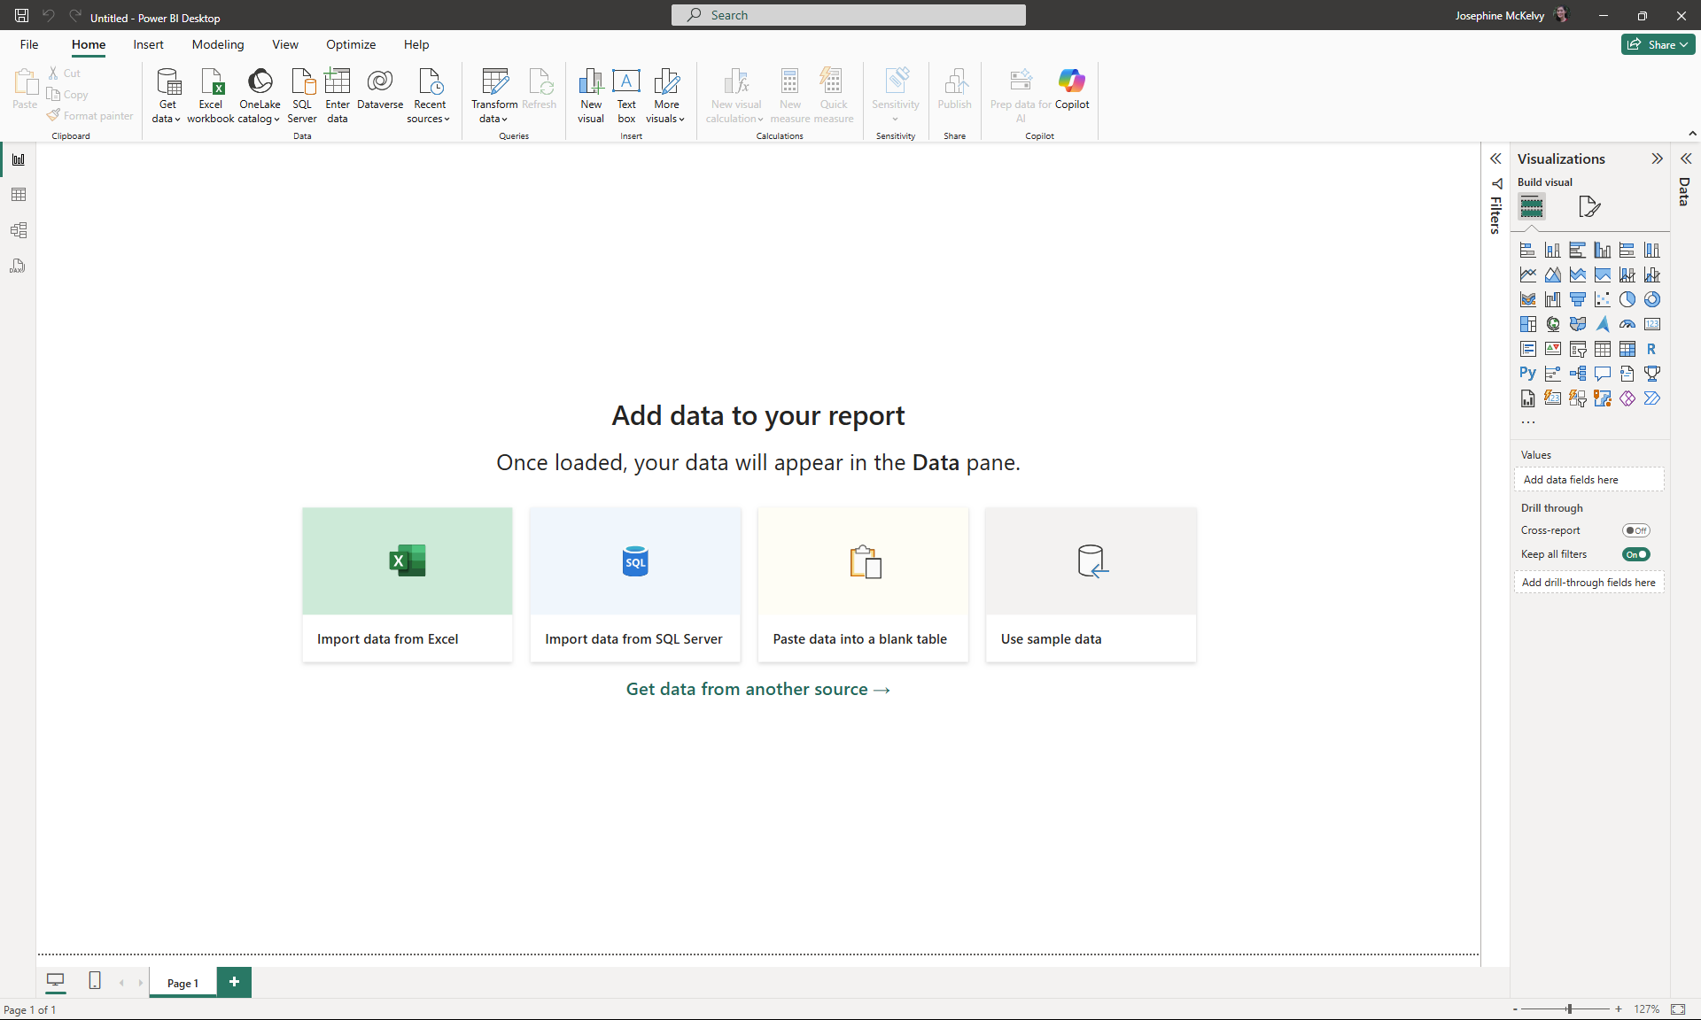
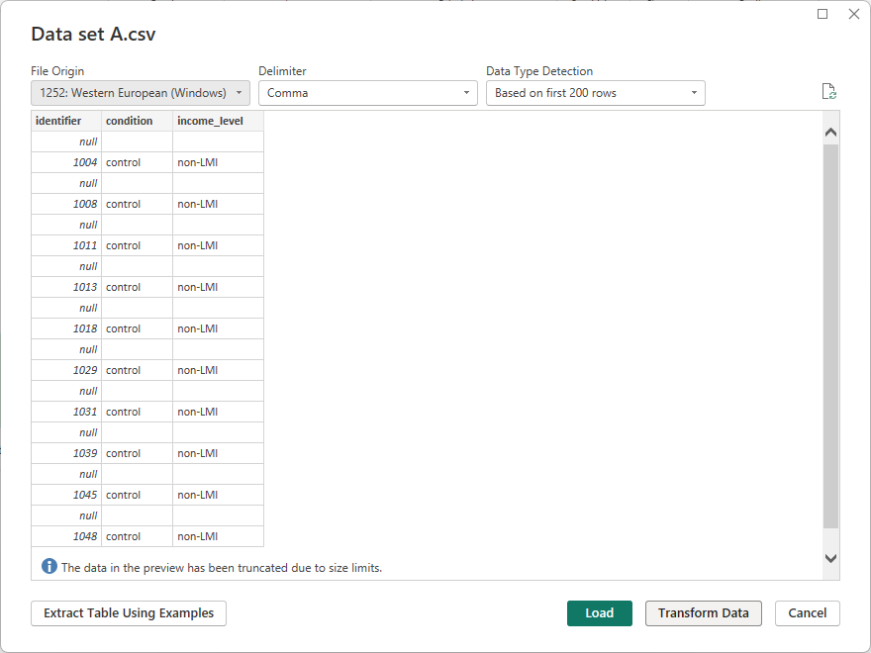

Slide 15
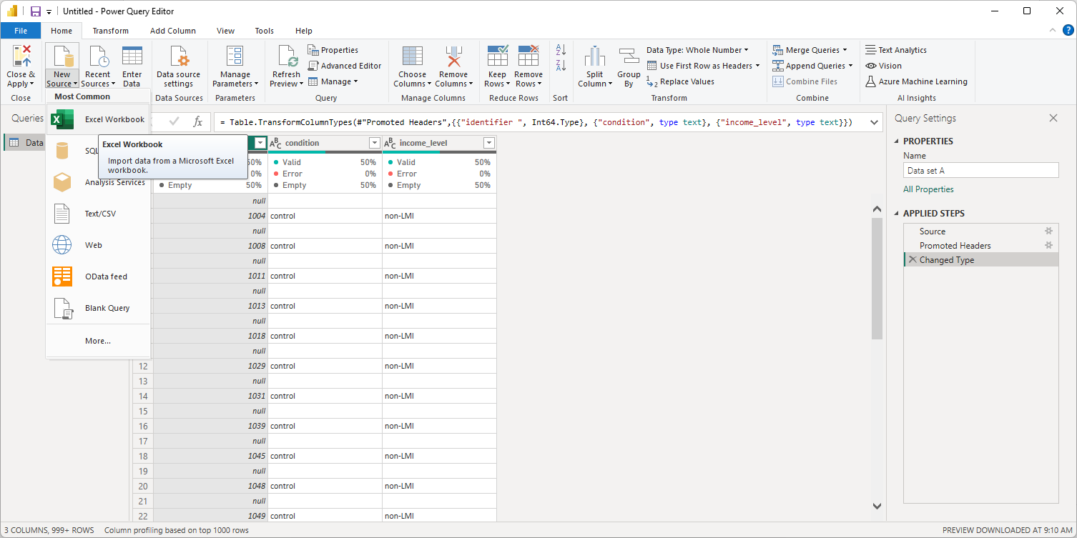
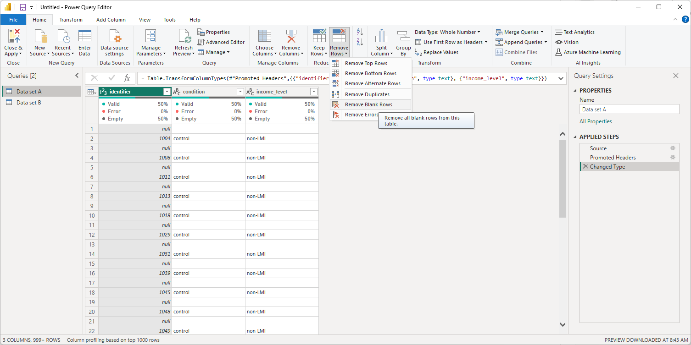
Notes:
Import additional data sets, or “queries”.

Slide 16
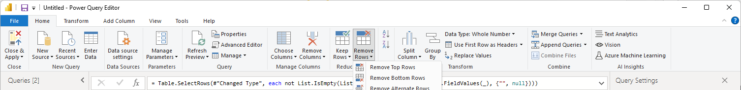
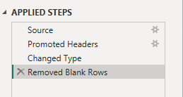
Every other row was null or empty.
Remove blank rows.

Slide 17
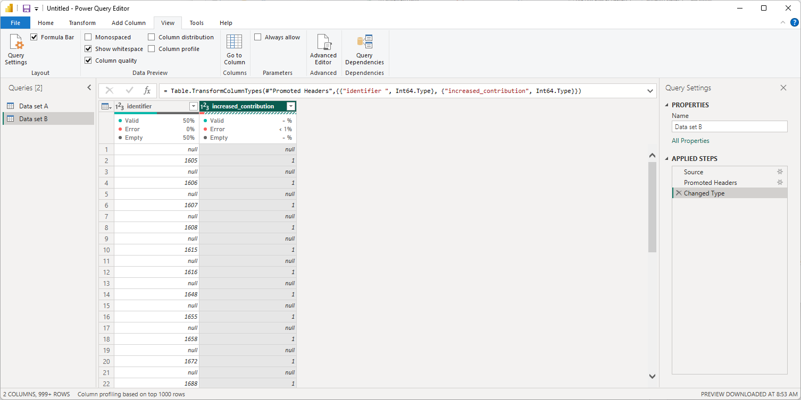
Data Type: Whole number
but categories were “1” and “closed”.
Delete this step to remove errors.

Slide 18
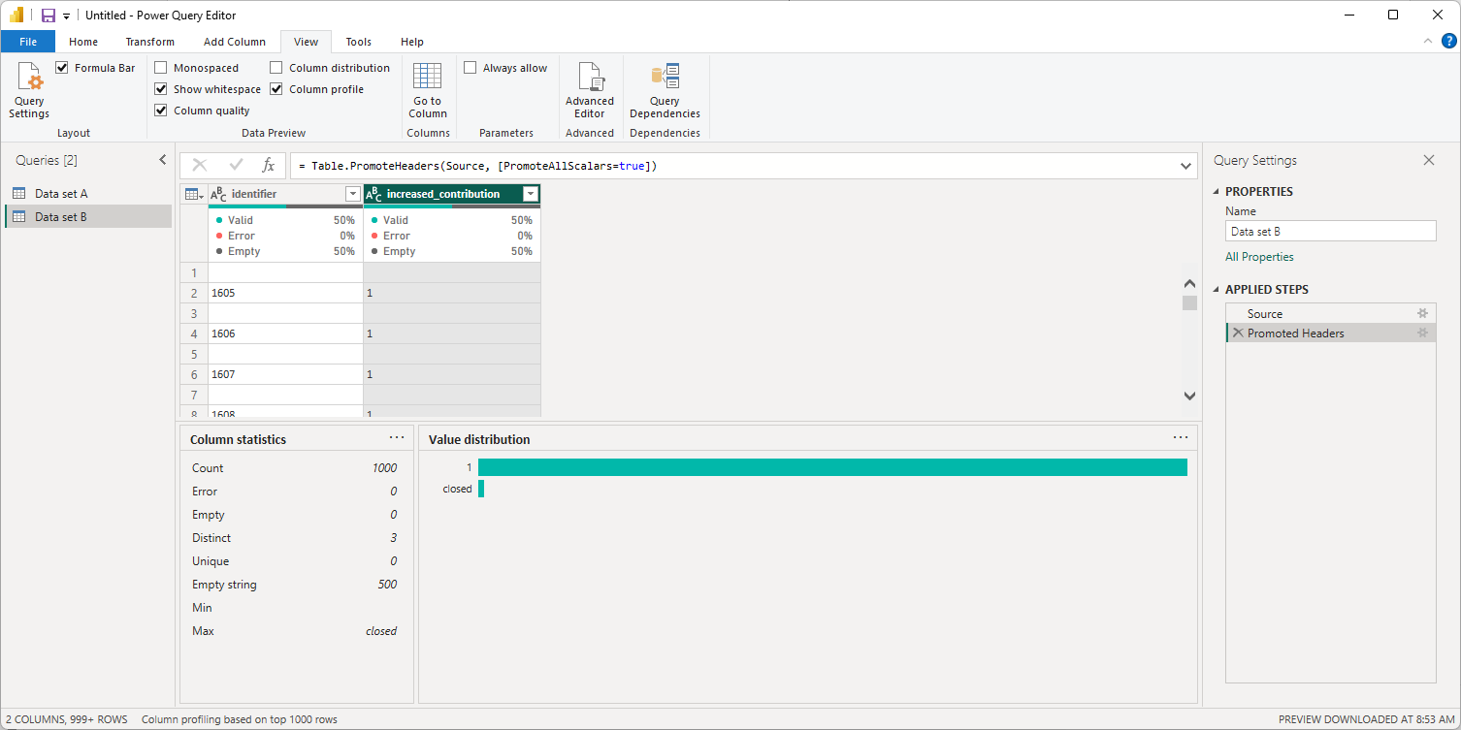
Notes:
View column profile to reveal that this dummy variable, increased_contribution, actually has catetgorical (text) values, which is why “closed” were errors in a numeric data type.

Slide 19
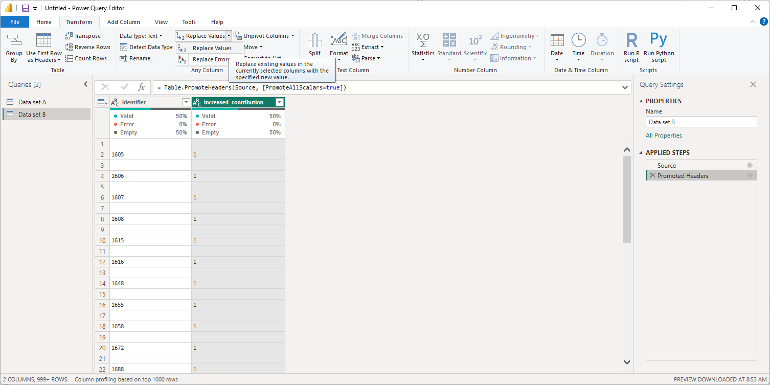
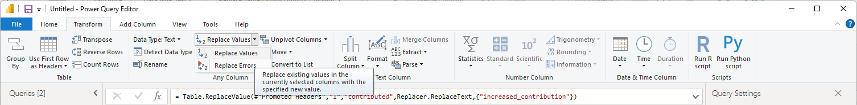
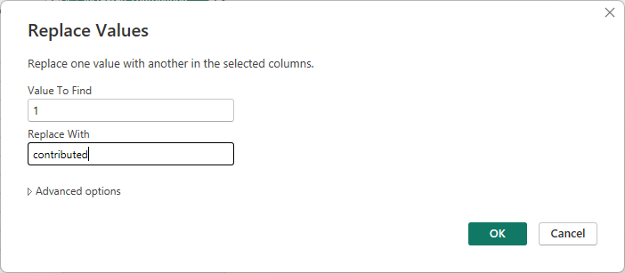
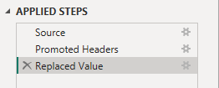

Slide 20
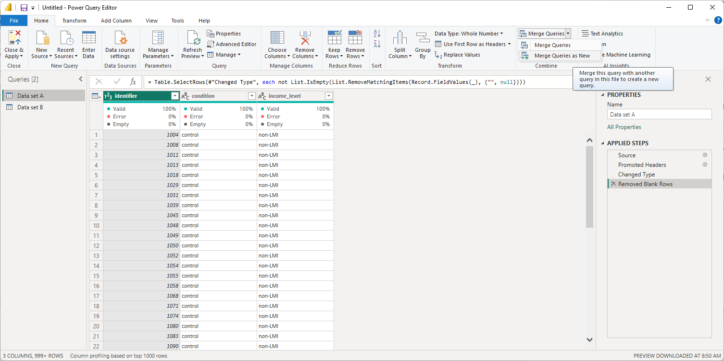
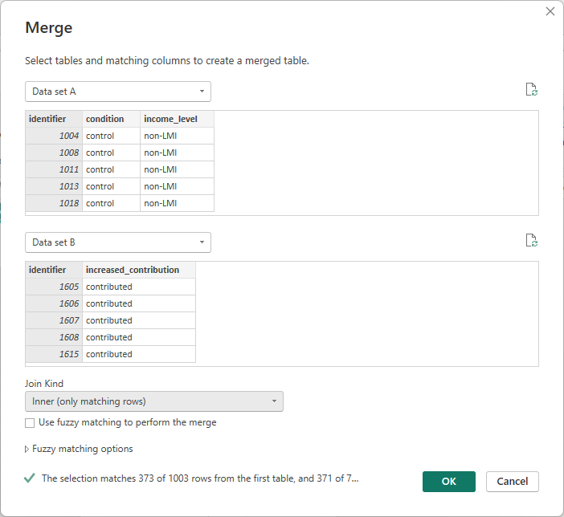
Notes:
Merge Queries (i.e., tables “Data set A” and “Data set B”) as New query (to be renamed “Inner”).
Merge (vs append) because you are adding column “increased_contribution” from Data set B to the columns of Data set A (vs rows)
Select tables & common key (with the same data type) between tables.
Select join
Inner = Analytic sample
373 rows
Demographics (condition, income) from Dataset A for IDs 1457-2000
Outcomes from Dataset B for IDs 1457-2000

Slide 21
IDs 1457-2000
Just demographics (n=171 of 544)
Both demographics AND outcomes (n=373 of 544)
(most of) DATA SET A IDs 1000-1456 (n=457 of 457) Demographics only
(most of) DATA SET B IDs 2001-2381 (n=381 of 381) Outcomes only
 |  | Data set A | Data set B
IDs 1000-1456 | (457 possible rows) | 457 rows* with only Demographics
IDs 1457-2000 | (544 possible rows) | 171 rows* with only Demographics 373 rows with Demographics | 373 rows with Outcomes
IDs 2001-2381 | (381 possible rows) |  | 381 rows with only Outcomes
 |  | 1001 total *reverse engineered | 754 total
Notes:
Merge Queries (i.e., tables “Data set A” and “Data set B”) as New query (to be renamed “Contiguous”).
Merge because you are adding column “increased_contribution” from Data set B to the columns of Data set A
Select tables & common key between tables.
Select join
Left Outer (all of blue circle)
1001 rows = 457 + 544
Demographics (condition, income) from Dataset A for IDs 1000-2000
Null outcomes for IDs 1000-1456 without outcomes in Dataset B
Outcomes from Dataset B for IDs 1457-2000
Right Outer (all of purple circle)
754 rows = 373 + 381
Demographics (condition, income) from Dataset A and outcomes from Dataset B for IDs 1457-2000
Outcomes from Dataset B for IDs 2001-2381 without demographics from Dataset A
Inner (convex)
373 rows
Demographics (condition, income) from Dataset A for IDs 1457-2000
Outcomes from Dataset B for IDs 1457-2000
Left Anti (c-shape)
630 rows = 457 + 171
Demographics (condition, income) from Dataset A for IDs 1000-2000 without outcomes from Dataset B
Right Anti (c-shape)
381 rows
Outcomes from Dataset B for IDs 2001-2381 without demographics from Dataset A

Slide 22
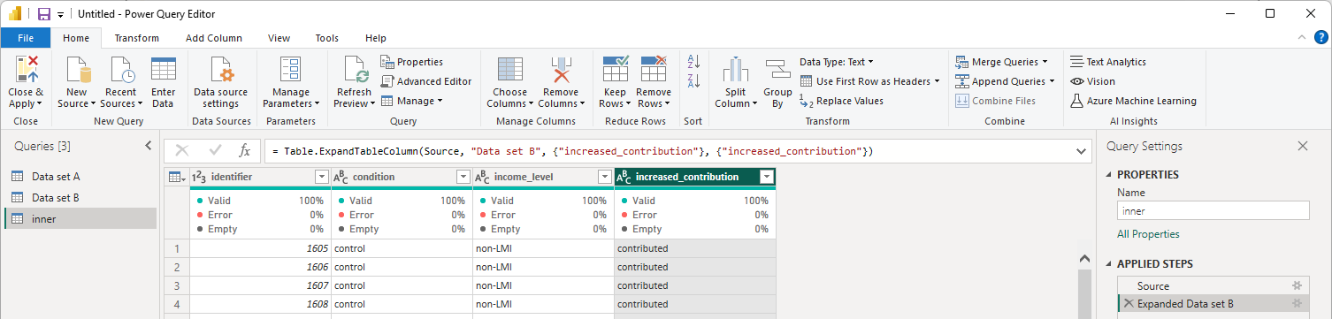
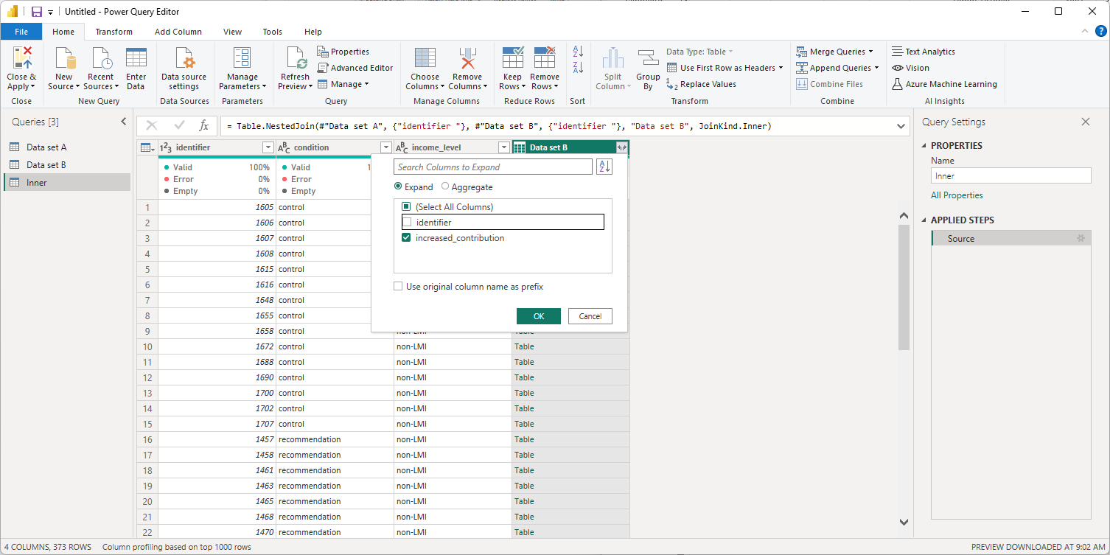
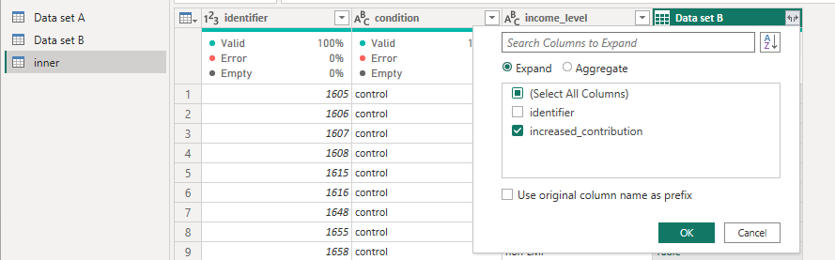
Notes:
Expand just the new columns added.

Slide 23
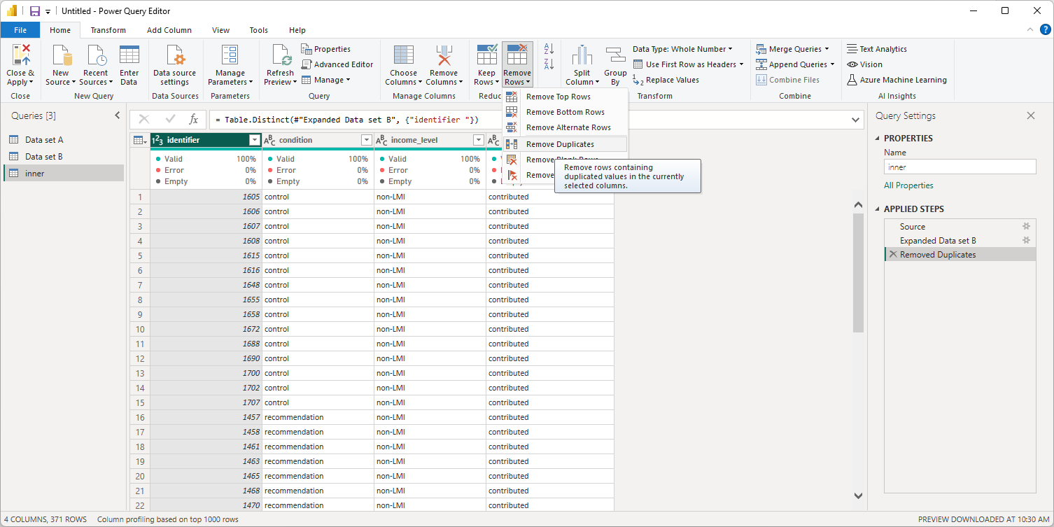
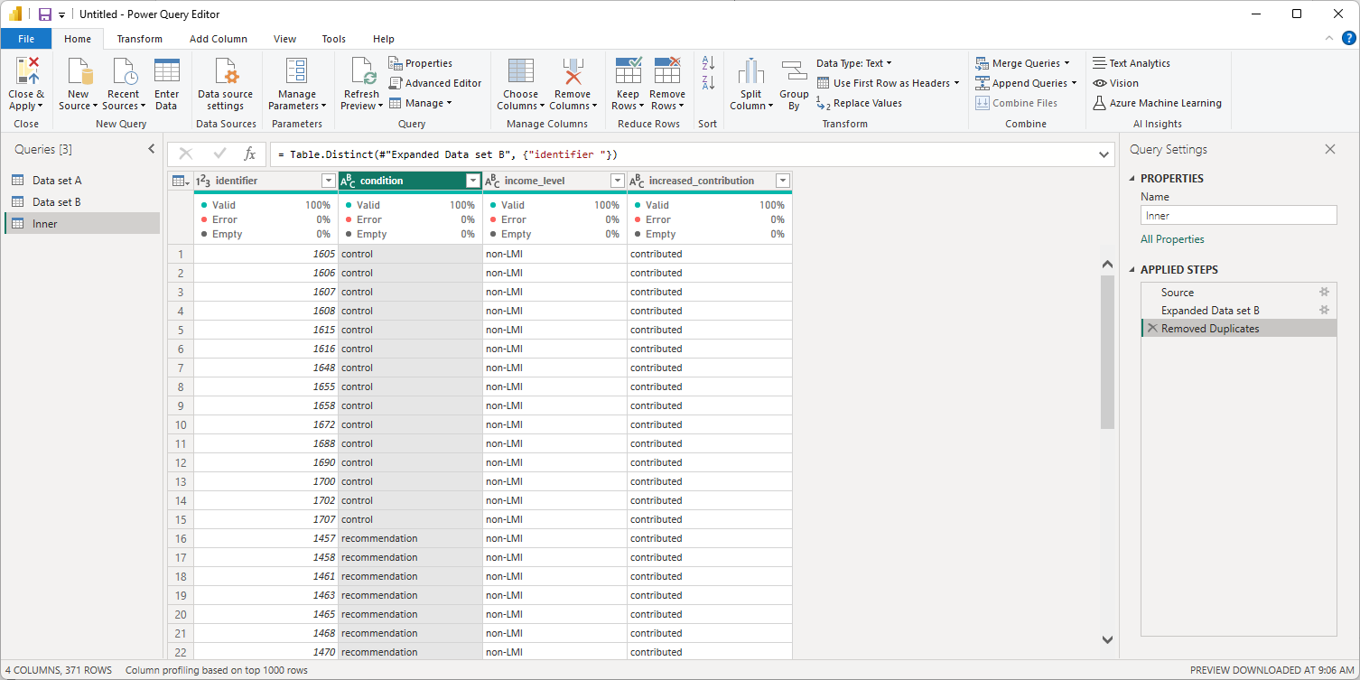
Notes:
Remove duplicate identifiers.

Slide 24
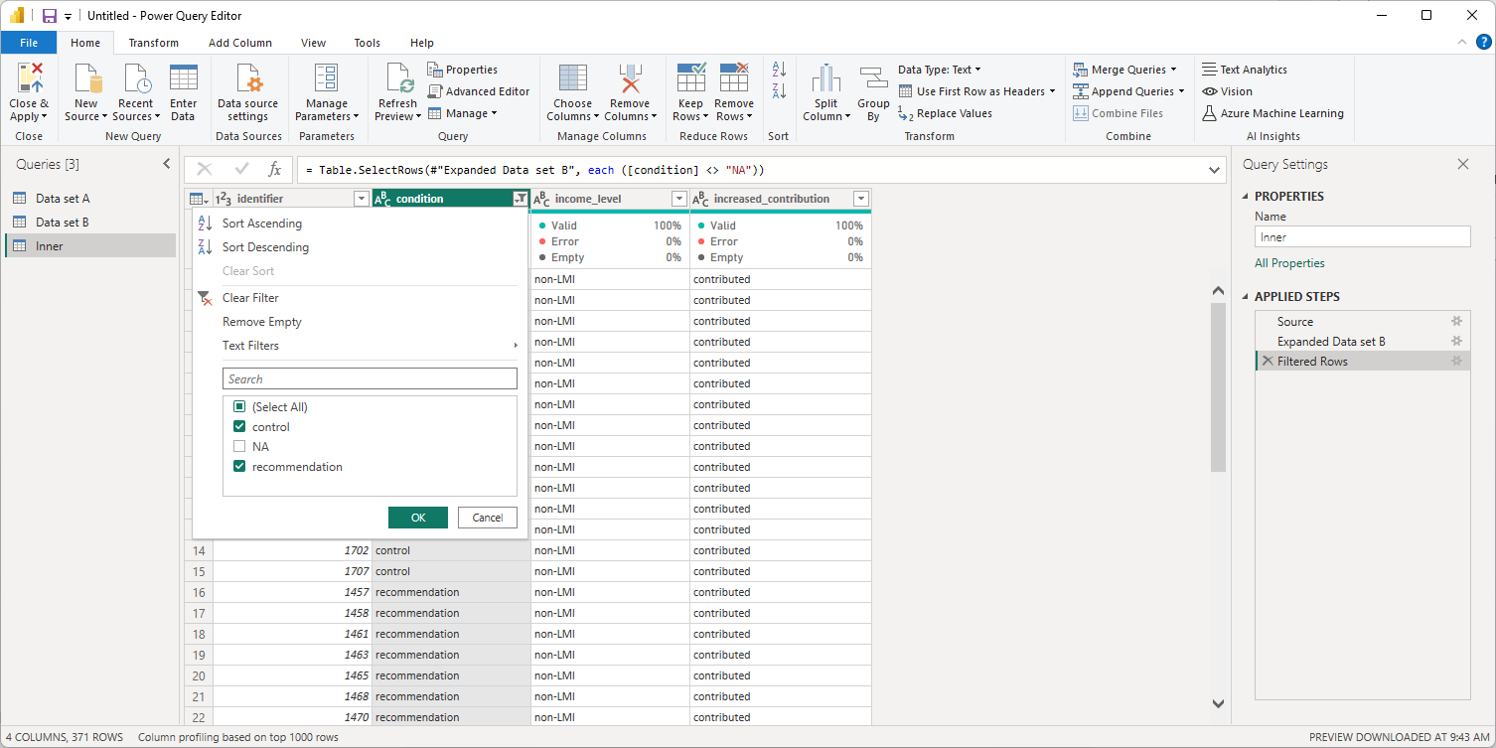
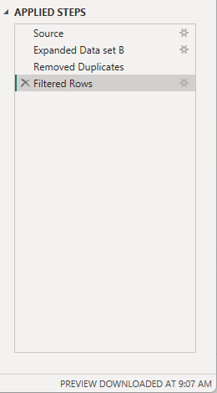
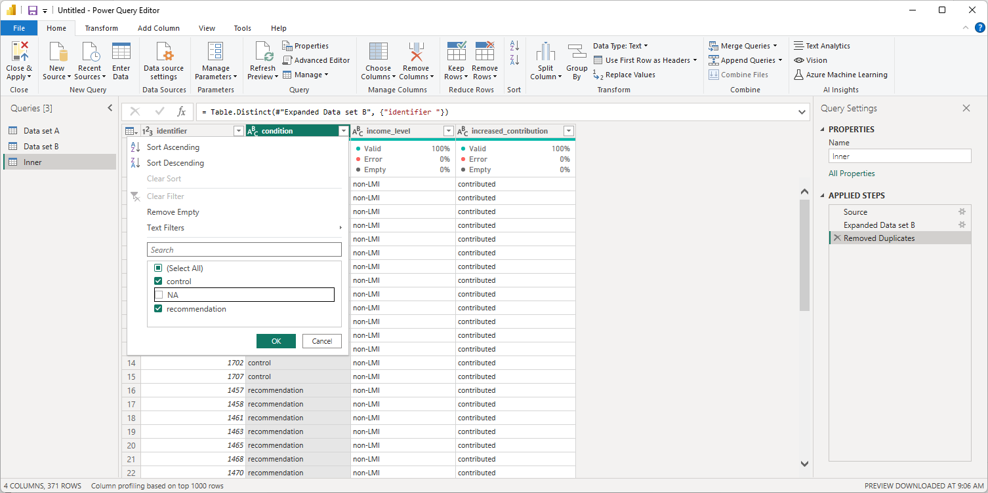
Notes:
Only include cases with an experimental condition.

Slide 26
https://rpubs.com/josephine-mckelvy/1327359

